Slide 1
SOCIOCULTURAL FOUNDATIONS FOR HPE IN SCHOOLS (9916)
Week 5 Semester 1 2024
Figurational Sociology 2 and Philosophy

Slide 2
LECTURE FORMAT
More on Figurational Sociology.
The dynamic nature of figurations and how they can be recreated using three levels.
Practical or everyday ‘philosophies’ in Physical Education.
© Dr. John Williams, Sociocultural Foundations for HPE in Schools, University of Canberra

Slide 3
Last Week
From the content covered last week you should now:
Be able to explain in your own words the term figurational sociology.
Know why figurational sociology is useful for understanding Physical Education (PE) in contemporary Australia.
Be able to define characteristics of figurations and figurational sociology.
Know how figurations can resemble social dances.
Have an overview of social power and other main theories associated with figurational sociology.
Understand key points in specified sections of the Week 4 Reading Williams and Pill (2021) manuscript about traditional Asian games.
Have a sense of what quality PE looks like in the practical setting and be able to describe quality PE from different perspectives using for example evidence-based frameworks/academic literature/policy documents.
© Dr. John Williams, Sociocultural Foundations for HPE in Schools, University of Canberra

Slide 4
Last Week Workshop
At the Week 4 workshop we played and analysed the following activities according to what extent they could be described as quality PE:
Activity 1: Stuck in the Mud
Activity 2: Edor
Activity 3: Chinese Wall
Activity 4: Dodge Ball
Activity 5: King Ball
Activity 6: Gorri
Activity 7: Wet Weather ‘Numbers’ Invasion Games
Activity 8: Wet Weather Theory Lesson
© Dr. John Williams, Sociocultural Foundations for HPE in Schools, University of Canberra

Slide 5
Week 5 Learning Outcomes
By the end of Week 5, from the readings, lecture and the workshop, students should:
Know that according to figurational sociology, knowledge is fluid or malleable, i.e., knowledge is not fixed or certain Week 5 Reading Green (2000).
Know that teachers in Green’s (2000) study held ‘practical philosophies’ of teaching PE rather than views informed by philosophy in an academic or traditional sense Week 5 Reading Green (2000)/Week 5 Lecture.
Understand how figurations can be recreated/described according to their macro, micro and sociogenesis characteristics and provide examples of each Week 5 Reading Williams (2018)/Week 5 Lecture.
Be able to describe and recognise each of the Dimensions and Elements of the A Classroom practice guide: Quality teaching in ACT schools (Australian Capital Territory Department of Education and Training, 2006) (see Week 5 Reading List).
Understand more about figurations and how they change over time Week 5 Workshop.
Know more about the different ways quality PE can be defined Week 5 Workshop.
Be able to explain the key messages in the first 18 pages of the United Nations Educational, Scientific and Cultural Organisation (2014) Quality Physical Education Guidelines available from https://unesdoc.unesco.org/ark:/48223/pf0000231101
© Dr. John Williams, Sociocultural Foundations for HPE in Schools, University of Canberra

Slide 6
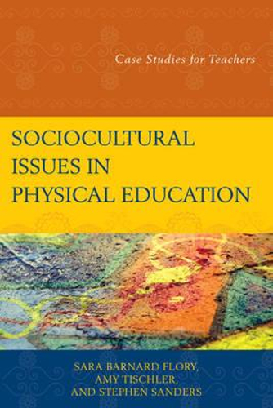
Sociocultural Case Study Week 5
Kevin is a Health and Physical Education (HPE) teacher at a Canberra High School. He has decided to complete an online course in the sociology of PE and Sport. Kevin has been studying figurational sociology as part of this course and he has learned that figurations can be recreated according to their macro, micro and sociogenesis levels.
How can Kevin use this knowledge about figurational sociology to understand why Aboriginal, Torres Strait Island and Asian games are rarely, if ever, taught in PE at his school?
© Dr. John Williams, Sociocultural Foundations for HPE in Schools, University of Canberra

Slide 7
MORE On FIGURATIONAL sociology

Slide 8
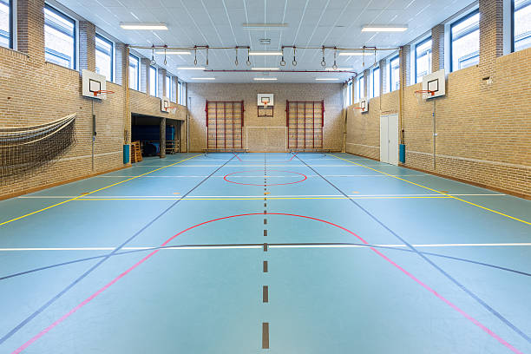
Figurational Sociology and the Concept of the Figuration
As some revision from last week, the idea of a figuration or configuration refers to:
How individuals are located interdependently in social structures characterised by relationships of power. In other words, people do not exist in isolation. Instead, they live as part of social groups where they are mutually dependent on each other.
See http://norbert-elias.com/ for summarised information about figurational sociology.
© Dr. John Williams, Sociocultural Foundations for HPE in Schools, University of Canberra

Slide 9
Types of Figurations
Within figurations, individual members can share common values, beliefs and ‘philosophies’ which we refer to as social habitus within figurational sociology. All of the members of any figuration are reliant upon each other to a greater or lesser extent. Examples of figurations include:
People who taught PE (formerly physical training) throughout the British Empire at the beginning of the twentieth century (global figuration).
All HPE teachers in Australia (national figuration).
A school community that includes the principal, teachers, non-teaching staff and parents (local figuration).
© Dr. John Williams, Sociocultural Foundations for HPE in Schools, University of Canberra

Slide 10
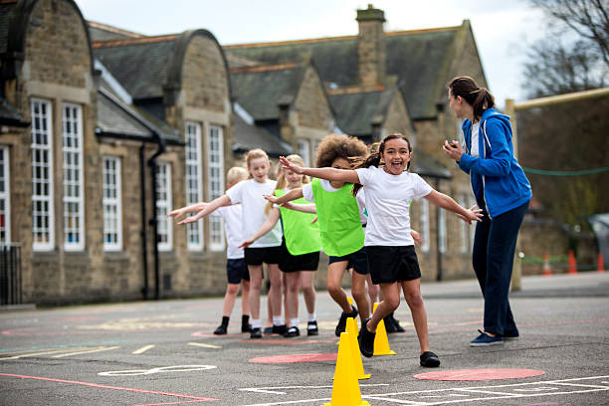
Why Figurational Sociology is Important in this Unit
Figurational sociology is important in this unit because it can be used to make sense of historical information – such as what we covered in Week 3. Importantly, figurational sociology recognises that the present is directly linked to the past.
Central to figurational sociology are long-term processes. These include the following for example that are relevant to this unit:
The development of PE since its beginnings as a subject at the beginning of the last century.
How sports activities have become less violent or more civilised over time.
Colonisation.
The introduction and development of curricula over time.
© Dr. John Williams, Sociocultural Foundations for HPE in Schools, University of Canberra

Slide 11
using three levels TO RECREATE The dynamic nature of figurations

Slide 12
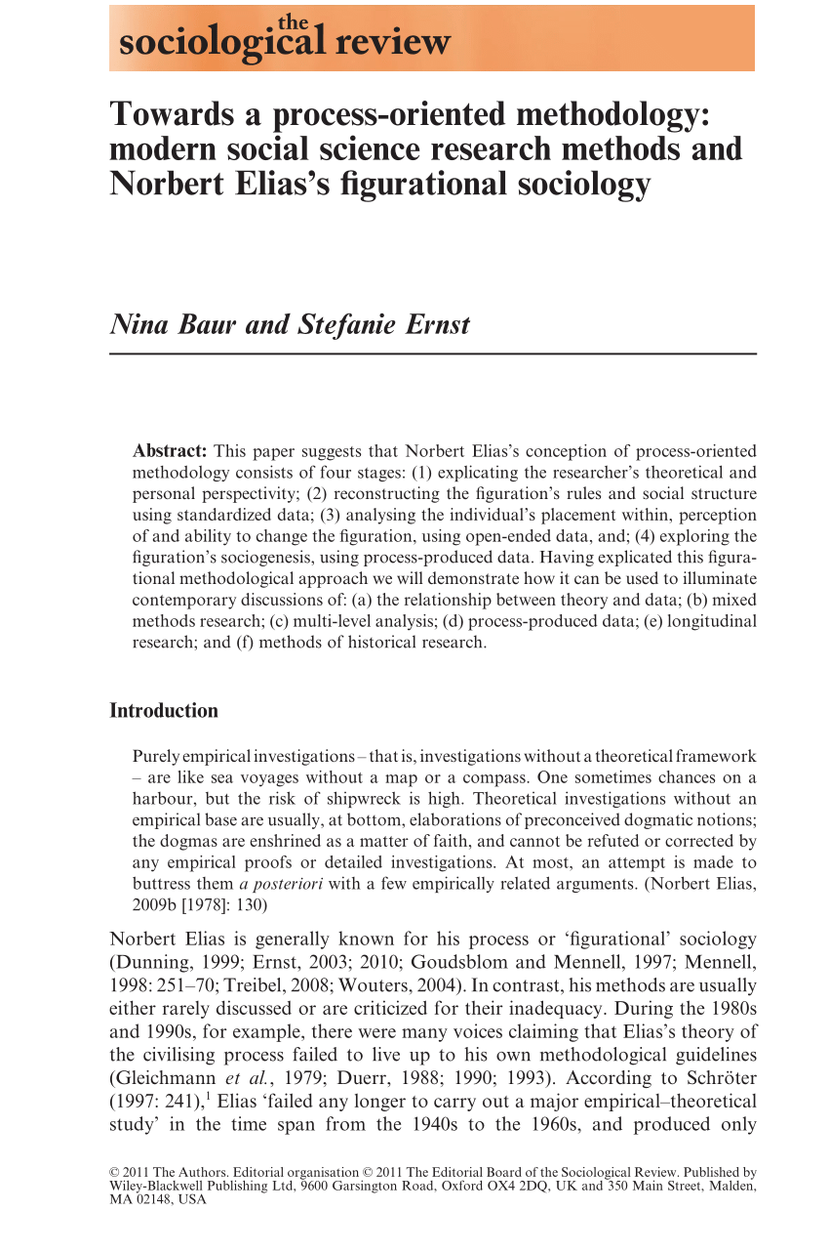
Different Levels of Figuration
According to Baur and Ernst (2011) any figuration can be depicted as having three different but inter-related levels:
Macro level: The macro level refers to the nature of the social structure and ‘rules’ within a given figuration and represents how a figuration exists in the present.
Micro level: The micro level is how individuals behave within a figuration. It is concerned with the values, beliefs and social power of the people it contains. The micro level also includes the extent to which members can influence the figuration.
Sociogenesis level: This is about how any figuration came to be. In other words, the history of how it was formed.
We will now consider a figuration that you can all relate to – that of the Australian School PE and School Sport (PE SS) Figuration.
© Dr. John Williams, Sociocultural Foundations for HPE in Schools, University of Canberra

Slide 13
The Macro Level of the Australian School PE SS Figuration
Within any high school in Australia there would be common features that would outline the social structure or ‘rules’ of the PE figuration. These similarities include:
Curricula – e.g., the Australian Curriculum for Health and Physical Education (Australian Curriculum Assessment and Reporting Authority, 2022).
Policy Documents – e.g., the Physical activity mandatory procedures (Australian Capital Territory Government Education, 2020); the Teachers’ code of professional practice (ACT Department of Education and Training [ACT DET], 2008); A classroom practice guide: Quality teaching in ACT schools (ACT DET, 2006).
School Structures and Routines – e.g., timetable documents, school start and finish times.
Facilities and Equipment – most schools have similar facilities based upon Victorian England designs. Most schools will have similar equipment.
State or Territory School Sports Organisations – e.g., School Sport ACT or equivalent. See http://www.schoolsportaustralia.edu.au/stateterritory-school-sport-offices/school-sport-act/ or Sporting Schools https://www.sportaus.gov.au/schools
© Dr. John Williams, Sociocultural Foundations for HPE in Schools, University of Canberra

Slide 14
The Micro Level of the Australian School PE SS Figuration
Within any school in Australia similar people would comprise the figuration. For example:
A school principal.
Specialist and non-specialist HPE teachers.
Teacher assistants.
In some cases, a Sports master or Sports co-ordinator.
Students.
Parents/carers.
Parent/carer helpers and volunteers.
After school sport staff.
Policy makers and decision makers beyond the physical boundaries of a given school.
© Dr. John Williams, Sociocultural Foundations for HPE in Schools, University of Canberra

Slide 15
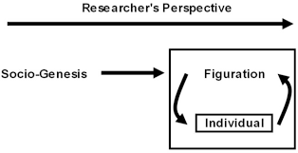
The Sociogenesis Level of the Australian School PE SS Figuration
The sociogenesis level of the PE SS figuration in any Australian school is about how the figuration ‘came to be’ (how it originated). As discussed last week, all figurations have a beginning and an end. In the ACT, one of our earliest school PE SS figurations as we know it, would have began in 1923. Importantly the sociogenesis of contemporary PE SS figurations are a consequence of:
The excess social power that curriculum and policy makers, HPE teachers and other powerful influential groups and individuals have.
Long term processes such as colonisation, Eurocentric influences.
The individual and social habitus of PE and HPE teachers, and others associated with school sport (see material from last week).
Established and outsider groups (Elias & Scotson, 1994).
© Dr. John Williams, Sociocultural Foundations for HPE in Schools, University of Canberra

Slide 16
Practical or everyday ‘philosophies’ in Physical Education

Slide 17
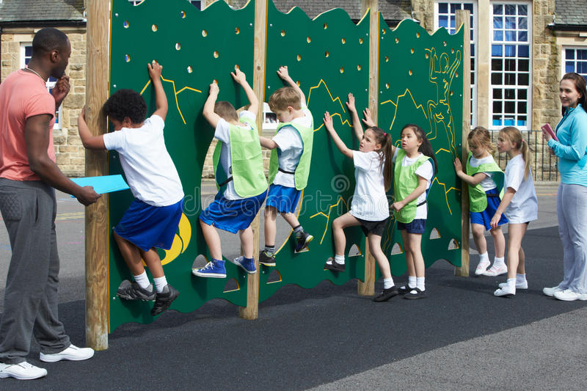
Philosophy of PE
In the Week 5 Reading (Green, 2000) the concept of philosophy in PE is introduced. According to Green (2000, p. 110) drawing on the work of Elias (1978) philosophy is:
“a classical theory of knowledge that centres conceptually upon the notion of ‘a solitary individual’ who ‘thinks, perceives, and performs’ in isolation in pursuit of ‘definite and certain knowledge’” (Elias, 1978, p. 110).
However, Green (2000) found in his study that Instead of philosophies, PE teachers had ideologies of PE that involved fantasies about what PE was. There was little evidence that PE teachers philosophised about what their subject was in the true or traditional sense of philosophy. Instead, they tended to just do PE teaching according to taken-for-granted practices, or their ‘everyday philosophies’ that were tied to their social habitus (see conclusion in paper – pages 125-127).
See also, the Week 2 Reading by Williams and Pill (2019) where we write about teacher ‘everyday philosophies’ in PE teaching.
© Dr. John Williams, Sociocultural Foundations for HPE in Schools, University of Canberra

Slide 18
Sociocultural Case Study Week 5
Kevin is a Health and Physical Education (HPE) teacher at a Canberra High School. He has decided to complete an online course in the sociology of PE and Sport. Kevin has been studying figurational sociology as part of this course and he has learned that figurations can be recreated according to their macro, micro and sociogenesis levels.
How can Kevin use this knowledge about figurational sociology to understand why Aboriginal, Torres Strait Island and Asian games are rarely, if ever, taught in PE at his school?
Using figurational sociology, Kevin is able to understand that the figuration for PE at his school is inextricably linked to the past and has shaped over time to be what it is now. Within this figuration HPE teachers are able to use their ‘everyday philosophies’ and habituses to decide what PE is, and is not. In other words, they can exercise their relative power within the figuration. Typically, despite the above games being mentioned in curricula since the 1990s and it being a requirement for these perspectives to be taught, many teachers do not teach this content. This is largely due to the sociogenesis of the school PE figurations where historical traditions are resistant to change.
© Dr. John Williams, Sociocultural Foundations for HPE in Schools, University of Canberra

Slide 19
REFERENCES
Australian Capital Territory Department of Education and Training. (2008). Teachers’ code of professional practice. Canberra,
Australia: Publishing Services for the ACT Department of Education and Training.
Australian Capital Territory Government Education. (2020). Physical activities mandatory procedures. Australian Capital Territory
Government Education.
Australian Capital Territory Department of Education and Training. (2006). A classroom practice guide: Quality teaching in
ACT schools. Canberra: Publishing Services for the ACT Department of Education and Training.
Australian Curriculum Assessment and Reporting Authority (ACARA) (2022) The Australian curriculum health and physical
education. Version 9. Australian Curriculum Assessment and Reporting Authority.
Baur, N. & Ernst, S. (2011). Towards a process-oriented methodology: Modern social science research methods and Norbert Elias’s figurational sociology. The Sociological Review, 59(s1), 117–139.
Dunning, E. (1999). Sport matters: Sociological studies of sport, violence and civilization. London, England: Routledge.
Elias, N. (1978). The civilizing process: The history of manners. Oxford, England: Basil Blackwell.
Elias, N. & Scotson, J. L. (1994). The established and the outsiders (Vol. 32). London, England: Sage Publications.
United Nations Educational, Scientific and Cultural Organization (2014) Quality physical education. Available at:
http://unesdoc.unesco.org/images/0023/002311/231101E.pdf
(accessed 2 March 2022).
© Dr. John Williams, Sociocultural Foundations for HPE in Schools, University of Canberra

